Slide 1
Money Markets

Slide 2
Call Money Market
Call money market is that part of the national money market where the day-to-day surplus funds, mostly of banks, are traded in.
Mostly the call money market helps the banks to borrow the money without collateral from other banks to maintain the cash reserve ratio (CRR) with RBI.
The loans made in this market are of a short-term nature, their maturity varying between one day to a fortnight.

Slide 3
Call Money Market Cont…
As on June 13, 2014 the standalone and bank primary dealers, which are existing in India are as follows: ICICI Securities Primary Dealership Limited, Morgan Stanley India Primary Dealer Pvt. Ltd., Nomura Fixed Income Securities Pvt. Ltd., SBI DFHI Ltd., STCI Primary Dealer Limited, Goldman Sachs (India) Capital Markets Pvt. Ltd., Bank of America, Bank Of Baroda, Canara Bank, Citibank N.A, Corporation Bank, HDFC Bank Ltd., Hongkong and Shanghai Banking Corpn. Ltd.(HSBC), J P Morgan Chase Bank N.A, Mumbai Branch, Kotak Mahindra Bank Ltd., Standard Chartered Bank, Axis Bank Ltd., IDBI Bank Limited, and Deutsche Bank AG.
Non-bank institutions (other than PDs) are not permitted in the call/notice money market.

Slide 4
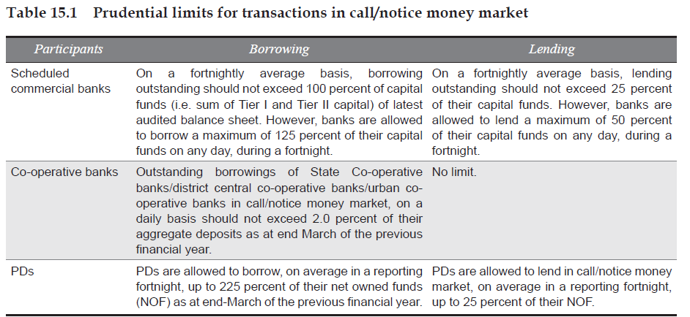
Call Money Market Cont…
All the money market transactions should be reported on the electronic platform called the Negotiated Dealing System (NDS).

Slide 5
Call Money Market Cont…
The seasonal nature of the call money market would be reflected in two indicators: (i) a decline in money at call and short notice should be greater in the slack season than in the busy season of a given year; (ii) an increase in money at call and short notice should be greater in the busy season than in the slack season.
The need for call money borrowings is the highest around March every year which may be due to withdrawals of deposits in March to meet year-end tax payments and withdrawals of funds by financial institutions to meet their statutory obligations.

Slide 6
Variations in Demand and Supply of Call Loans
The supply of call loans
Increase in deposits
Demand for Call Loans
Buoyancy of the stock market
Increase in the demand for loans for industrial and commercial purposes
Liquidation of government securities
Subscriptions to government loans
Seasonal demand
RBI policy measure

Slide 7
Call Rates
The rate of interest paid on call loans is known as the call rate. The call rate is highly variable from day to day, and often from hour to hour. It is very sensitive to changes in demand for and supply of call loans.
The call rate has been freely determined by the market forces since 1989.
Mostly the call rate in India is defined as interbank call rate.

Slide 8
Reasons for Call Rate Volatility
Requirement for CRR needs create excess demand for liquidity in call money market
Over extended credit position of Banks
Occasional market disruptions
Heavy withdrawal by Institutional investors
Liquidity crisis in money market
Sluggish demand in bank deposit with heavy pressure for non-food credit in the banking sector crating asset liability mismatch
Causality in foreign exchange market and call money market
Structural deficiencies in the Banking Sector

Slide 9
Mumbai Inter-Bank Bid Rate (MIBID) and Mumbai Inter-Bank Offer Rate (MIBOR)
It is the interest rate at which banks can borrow funds, in marketable size, from other banks in the Indian interbank market.
It is calculated daily by the National Stock Exchange of India (NSE).
It is calculated on the basis of data collected from the panel of 30 banks and primary dealers. The panel has a mix of public sector banks including SBI, CBI; private sector banks including Axis Bank Ltd, HDFC Bank Ltd; foreign banks including Citibank NA and Deutsche Bank; and primary dealers including ICICI Securities Ltd and PNB Gilts Ltd.

Slide 10
London Inter-Bank Offer Rate (LIBOR)
It is an interest rate at which banks can borrow funds in marketable size from other banks in the London interbank market.
The LIBOR is fixed on a daily basis by the British Bankers’ Association (BBA).
LIBOR formally measures the cost of this inter-bank lending and setting out the average rate banks pay to borrow from one another.

Slide 11
Term Money Market and Repo Market
In term money market where the tenor of the transactions is from 15 days to one year.
Repo or ready forward contact is an instrument for borrowing funds by selling securities with an agreement to repurchase the said securities on a mutually agreed future date at an agreed price which includes interest for the funds borrowed.
The reverse of the repo transaction is called ‘reverse repo’ which is lending of funds against buying of securities with an agreement to resell the said securities on a mutually agreed future date at an agreed price which includes interest for the funds lent.

Slide 12
Collateralised Borrowing and Lending Obligation (CBLO)
CBLO is another money market instrument operated by the Clearing Corporation of India Ltd. (CCIL), for the benefit of the entities who have either no access to the interbank call money market or have restricted access in terms of ceiling on call borrowing and lending transactions.
It was operationalised with effect from January 20, 2003
CBLO is a discounted instrument available in electronic book entry form for the maturity period ranging from one day to ninety days (up to one year as per RBI guidelines).
In order to enable the market participants to borrow and lend funds, CCIL provides the Dealing System through Indian Financial Network (INFINET), a closed user group to the Members of the Negotiated Dealing System (NDS)

Slide 13
Collateralised Borrowing and Lending Obligation (CBLO) Cont…
It is an obligation by the borrower to return the money borrowed, at a specified future date
Provides authority to the lender to receive money lent, at a specified future date with an option/privilege to transfer the authority to another person for value received
It is underlying charge on securities held in custody (with CCIL) for the amount borrowed/lent.

Slide 14
Treasury Bill Market
A Particular type of Finance Bill or Promissory note put out by the Govt. of the country to meet the needs of supplementary short-term Finance
Treasury bills are zero coupon securities and pay no interest.
Issued at discount and redeemed at par

Slide 15
Characteristics
High Liquidity Money Market Instrument
Absence of Risk of Default
Ready availability
Assured Yield
Low transaction Cost
Eligibility for Inclusion in SLR
Negligible Capital Depreciation

Slide 16
Types of Treasury Bills
91-Day, 182-Day and 364-Day Treasury Bills: Marketable
14-Day Intermediate Treasury Bills: It is sold only to state governments in order to to replenish shortfall in the daily minimum cash balances of State Governments

Slide 17
Investors and Sale of T-bills
Banks, Primary Dealers, State Governments, Provident Funds, Financial Institutions, Insurance Companies, NBFCs, FIIs (as per prescribed norms), NRIs & OCBs can invest in T-Bills
Treasury bills are available for a minimum amount of Rs.25,000 and in multiples of Rs. 25,000
T- bills are sold through auction

Slide 18
Auction Process
Auction is a process of calling of bids with an objective of arriving at the market price
A yield based auction is generally conducted when a new Government security is issued.
Investors bid in yield terms up to two decimal places (for example, 7.49 per cent, 8.21 per cent, etc.).
Bids are arranged in ascending order and the cut-off yield is arrived at the yield corresponding to the notified amount of the auction.
The cut-off yield is taken as the coupon rate for the security.
Successful bidders are those who have bid at or below the cut-off yield. Bids which are higher than the cut-off yield are rejected.

Slide 19
Auction Process Cont…
A price based auction is conducted when Government of India re-issues securities issued earlier.
Bidders quote in terms of price per Rs.100 of face value of the security (e.g., Rs.102.00, Rs.101.00, Rs.100.00, Rs.99.00, etc., per Rs.100/-).
Bids are arranged in descending order and the successful bidders are those who have bid at or above the cut-off price.
Bids which are below the cut-off price are rejected.

Slide 20
Uniform Price Vs. Multiple Price based Auction
In a Uniform Price auction, all the successful bidders are required to pay for the allotted quantity of securities at the same rate, i.e., at the auction cut-off rate, irrespective of the rate quoted by them
Multiple Price auction, the successful bidders are required to pay for the allotted quantity of securities at the respective price / yield at which they have bid

Slide 21
Competitive Vs. Non-Competitive Bidding
Competitive bids
Made by well informed investors such as banks, financial institutions, primary dealers, mutual funds, and insurance companies.
The minimum bid amount is Rs.10, 000 and in multiples of Rs.10, 000 thereafter.
Multiple bidding is also allowed, i.e., an investor may put in several bids at various price/ yield levels.
Non-competitive bidding
Open to individuals, HUFs, RRBs, co-operative banks, firms, companies, corporate bodies, institutions, provident funds, and trusts.
Under the scheme, eligible investors apply for a certain amount of securities in an auction without mentioning a specific price / yield. Such bidders are allotted securities at the weighted average price / yield of the auction

Slide 22
Trading Platform
T-bills auctions are held on the Negotiated Dealing System (NDS)
The 91 day T-bills are auctioned on every Wednesday.
The Treasury bills of 182 days and 364 days tenure are auctioned on alternate Wednesdays.

Slide 23
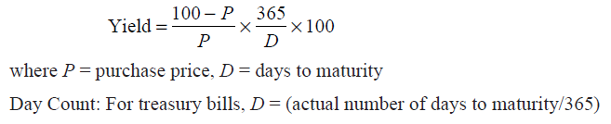
Treasury Bill Rate
Treasury bill rate is the rate of interest at which treasury bills are sold by the RBI.
The effective return on treasury bills is the discount at which they are sold, and is based on the difference between the price at which they are sold and their redemption value.
Yield of the T-bill

Slide 24
Other Short-term Central Government Securities
Cash Management Bills (CMBs)
Issued to meet the temporary mismatches in the cash flow of the Government
maturities less than 91 days
issued at a discount and redeemed at face value at maturity
tenure, notified amount and date of issue of the CMBs depends upon the temporary cash requirement of the Government
The settlement of the auction is on T+1 basis.
Ways and Means Advances (WMA)
Issued to help the states to tide over temporary mismatches in the cash flow of their receipts and payments
Normal WMA are clean advances, special WMA are secured advances provided against the pledge of Government of India dated securities

Slide 25
What is Commercial Paper?
CP is an unsecured money market instrument issued in the form of a promissory note by a corporation with high credit ratings to finance its short-term needs.
CPS can be issued in a wide range of denominations, can be either discounted or interest-bearing, and usually have a limited or nonexistent secondary market.

Slide 26
Characteristics of CPs
CPs can be issued on discount to face value basis or on a fixed interest basis.
CPs are unsecured, negotiable by endorsement and normally have a buy-back facility
CPs as a source of short-term debt regarded as highly safe, simple, flexible, and quality liquid instrument

Slide 27
CPs in India
It was introduced in India in 1990 with a view to enabling highly rated corporate borrowers to diversify their sources of short-term borrowings and to provide an additional instrument to investors. Subsequently, primary dealers and all-India financial institutions were also permitted to issue CP to enable them to meet their short-term funding requirements for their operations
Corporates, primary dealers (PDs) and the All-India Financial Institutions (FIs) are eligible to issue CP.

Slide 28
CPs in India
The tangible net worth of the company, as per the latest audited balance sheet, is not less than Rs.4 crore
CP can be issued in denominations of Rs.5 lakh or multiples thereof.
The fund based working capital of the company should not be less than 4 crore
Every issue of CP, including renewal, should be treated as a fresh issue.
There is no lock in period for CPs

Slide 29
CPs in India
CP can be issued for maturities between a minimum of 7 days and a maximum up to one year from the date of issue ( since October 2004).
Individuals, banking companies, other corporate bodies (registered or incorporated in India) and unincorporated bodies, Non-Resident Indians (NRIs) and Foreign Institutional Investors (FIIs) etc. can invest in CPs.
The total amount of CP proposed to be issued should be raised within a period of two weeks from the date on which the issuer opens the issue for subscription.
Mandatory credit rating for issuance of Commercial Paper. The minimum credit rating shall be P-2 of CRISIL and A2 for ICRA.

Slide 30
Role and responsibilities of the Issuer
Every issuer must appoint an issuing and paying agent (IPA) for issuance of CP.
The issuer should disclose to the potential investors its financial position as per the standard market practice.
After the exchange of deal confirmation between the investor and the issuer, issuing company shall issue physical certificates to the investor or arrange for crediting the CP to the investor's account with a depository.

Slide 31
Role and responsibilities of IPA
IPA would ensure that issuer has the minimum credit rating as stipulated by the RBI and amount mobilised through issuance of CP is within the quantum indicated by CRA for the specified rating or as approved by its Board of Directors, whichever is lower.
IPA has to verify all the documents submitted by the issuer viz., copy of board resolution, signatures of authorised executants (when CP in physical form) and issue a certificate that documents are in order. It should also certify that it has a valid agreement with the issuer
Certified copies of original documents verified by the IPA should be held in the custody of IPA.

Slide 32
Factors affecting CP Market Development
Credit quality of CP issuer
Market liquidity
Cost of other alternative assets
Financial market infrastructure
Working capital limit

Slide 33
Certificate of Deposit (CD)
CDs represent bank deposit accounts which are transferable from one party to another.
Marketable nor negotiable short-term instruments in bearer from and are known as Negotiable Certificate of Deposit (NCDs)
Liquidity and marketability as its hallmark
CDs are issued by banks for attracting large corporate deposits rather mobilising individual savings
The introduction of CDs in an economy has usually preceded the introduction of CPs

Slide 34
CDs in India
In initial years (1980-1987) feasibility of CDs in India is subject to various constraints like lack of secondary money market, administered interest rates, lack of proper regulatory system
Introduction of CDs in 1989 : recommendation of RBI working group on money market (Vaghul working group, 1987)
Broad objective is to further widen the range of money market instruments and to give investors greater flexibility in the deployment of short term surplus funds

Slide 35
CDs in India Cont…
CDs can be issued by (i) scheduled commercial banks {excluding Regional Rural Banks and Local Area Banks}; and select All-India Financial Institutions (FIs)
Banks have the freedom to issue CDs depending on their funding requirements.
Minimum amount of a CD should be Rs.1 lakh, i.e., the minimum deposit that could be accepted from a single subscriber should not be less than Rs.1 lakh, and in multiples of Rs. 1 lakh thereafter.
CDs can be issued to individuals, corporations, companies (including banks and PDs), trusts, funds, associations, etc. Non-Resident Indians (NRIs) may also subscribe to CDs
The maturity period of CDs issued by banks should not be less than 7 days and not more than one year, from the date of issue.
The FIs can issue CDs for a period not less than 1 year and not exceeding 3 years from the date of issue.
CDs may be issued at a discount on face value.

Slide 36
CDs in India Cont…
All CDs were subject to cash reserve ratio (CRR) and statutory liquidity ratio (SLR) requirement , on the issue price of the CDs.
Banks / FIs cannot grant loans against CDs and cannot buy-back their own CDs before maturity.
CDs are freely transferable by endorsement and delivery
RBI Guidelines for Issue of CDs with respect to The maturity period, Minimum Size of Issue and Denominations modified from time-to-time
Mutual funds are allowed to invest in CDs with cretin limit stipulated by Securities Exchange Board of India (SEBI)

